Slide 1
Electric Cooking in Kampala
Technology Review
Eric Behling, Ahana Mukherjee,
Rodney A Perez, Sarah Yasuda
CSE 583 - Autumn 2023

Slide 2
Background
Objective & Scope Examine trends in power quality through studying power consumption, voltage and frequency stability on an events basis when electric appliances are in use in informal community settlements in Kampala, Uganda.
Method
Disaggregate temporal electric sensor meter data for analysis and processing
Comparative study of survey responses in relation to energy consumption data

Slide 3
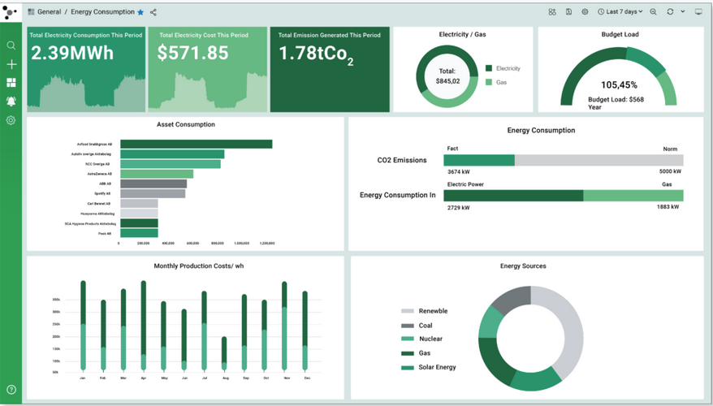
Software Application
Output
Create an interactive dashboard for data visualization and results for the following stakeholders:
Research team
Utility
Policymakers
Blue Sky
Dashboard contains visualization that updates in real-time as remote sensors capture voltage, current, frequency, and power measurements
Input
Processing
Visualization

Slide 4
Technology Considerations & Selection
NumPy Array and matrix manipulation
Pandas Dataframe creation; merging and processing data sets
Matplotlib Preliminary data visualization
Seaborn Detailed statistical data visualization
Dash + Plotly.js Dashboard creation and integration
Notes:
The plan is to use all of the packages mentioned in slide 3. For purpose of presentation, we’ll focus on the appeal and drawbacks of the Dash package

Slide 5
Seaborn Package
Plot types: multivariate views, categorized plots, statistical relationships plot, pairplot, heatmap, boxplot etc.
Appeal | Drawbacks
Builds on top of Matplotlib; integrates with Pandas | Memory intensive for complex datasets
Ability to switch between plot styles quickly | Compatibility issues (i.e. with Dash, etc.)
Automatically perform statistical calculations | Newer development, possibly prone to bugs
Simple one functional call for graphics creation | Less flexibility compared to Matplotlib
Notes:
mwaskom/seaborn: Statistical data visualization in Python (github.com)
https://www.linkedin.com/advice/3/what-advantages-disadvantages-using-seaborn

Slide 6
Dash Package (created by Plotly)
Layout: defines the elements such as graphs, dropdowns, placement, size, color (HTML)
Callback: creates interactivity of application
Appeal | Drawbacks
Interactive capabilities | Learning curve (prior HTML experience)
Aesthetic appeal | Formatting limitations
Integration with Jupyter Notebooks | Dependent on server callbacks (less efficient than using Javascript code)
Eliminates the need for Javascript, HTML, CSS | Free features only allow hosting dashboard locally
Notes:
Matplotlib along with Flask can be used to create preliminary dashboards but Dash simplifies the process an adds a level of interactivity and aesthetic appeal
https://hex.tech/blog/how-to-build-a-dashboard-in-python/
https://towardsdatascience.com/dash-for-beginners-create-interactive-python-dashboards-338bfcb6ffa4’
https://medium.datadriveninvestor.com/plotly-dash-everything-you-need-to-know-bc09a5e45395#af12
https://medium.com/analytics-vidhya/5-challenges-when-using-plotly-dash-for-interactive-web-apps-849f442582f7

